Slide 1
CTF model for long reverberation Date：2022. 05. 17
Telecom Electroacoustics Audio(TEA) Lab
Presenter:
Anchi Yuan
Notes:
Hello everyone
I’m today’s presenter siang. I’m going to share some of my present work in source separation problem. My topic is comparative studies of source separation using semi-blind and blind source separation approaches.

Slide 2
Outline
Simulation settings
Specify parameters
ATF estimation
Microphone received signal with different parameters and reverberation time
Conclusions
Future work

Slide 3
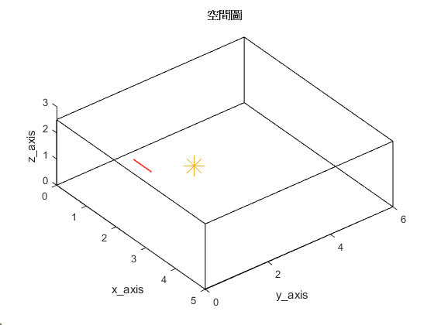

Simulation settings
Uniform linear array (ULA)
Number of microphones = 30
Spacing = 0.02m (2cm)
Aperture = (30-1)*0.02 = 0.58 m
Room size = 5m $×$6m $×$2.5m
Sampling frequency = 16kHz
Reverberation time T₆₀ = 0.2s 0.4s 0.6s
First microphone location [1, 1.5, 1]
2.5m
origin
Source location [2, 2.6, 1]
5m
6m

Slide 4
Specify parameters
Time domain convolution |  |  | ATF pts | NWIN_H | hopsize_H
 |  |  |  | 64 | 64
 |  |  | Source pts | NWIN | hopsize
 |  |  |  | 2048 | 64
time |  |  | ATF with short window, source with long window (Ref)
ATF pts | NWIN_H | hopsize_H | ATF pts | NWIN_H | hopsize_H
 | 64 | 32 |  | 2048 | 1024
Source pts | NWIN | hopsize | Source pts | NWIN | hopsize
 | 64 | 32 |  | 2048 | 1024
both short window with half hopsize |  |  | both long window with half hopsize

Slide 5
ATF estimation (1)
rms = 0.2444
Ground-truth RIR
T₆₀ = 0.2s
Ref
rms = 0.4546
rms = 0.0823
both short window with half hopsize
both long window with half hopsize

Slide 6
ATF estimation (2)
rms = 0.4739
Ground-truth RIR
T₆₀ = 0.4s
Ref
rms = 0.588
rms = 0.3204
both short window with half hopsize
both long window with half hopsize

Slide 7
ATF estimation (3)
rms = 0.6048
Ground-truth RIR
T₆₀ = 0.6s
Ref
rms = 0.6565
rms = 0.4016
both short window with half hopsize
both long window with half hopsize

Slide 8

Microphone received signal with different parameters and reverberation time
Microphone received signal | time | Ref | both short window with half hopsize | both long window with half hopsize
T₆₀ = 0.2s
T₆₀ = 0.4s
T₆₀ = 0.6s

Slide 9
Conclusions
Although ATF and source both with long window has lowest rms, it waveform differ from ground-truth RIR
ATF with short window and source with long window (Ref) will get acceptable waveform and low rms
ATF with short window and source with long window (Ref) can perfectly simulate CTF model

Slide 10
Future work
Use cosine similarity for estimating ATF
Source predictions
Blind system ID → Benesty’s approaches

Slide 11


